Slide 1

Hospital Appointment System
Using Linked List &Stack

Slide 2
Objectives..
The aim of this project is to design and implement a console based Hospital Administration System that allows patient to book,view,cancel and restore appointments
The system uses Linked Lists to store patient appointment details and a Stack to manage cancellations,ensuring efficient data handling.

Slide 3
Data Structures Used…
1.Linked List
2.Stack
To store booked Appointments
To view Appointments
To store cancelled Appointments(push)
To restore cancelled Appointments(pop)

Slide 4
Why Linked List?...
Dynamic Memory Allocation
Memory can be allocated allocated at time run time
Efficient Insertions
The insertion of node can be done at desired positions
Easy Deletions
Like insertion deletion can be done at desired positions

Slide 5
Why Stack is used?
LIFO (Last In, First Out)
The last appointment that was canceled is the first one that should be
restored
Undo Functionality
Push = Save canceled appointment.
Pop = Restore last canceled appointment
Simple Implementation
With just push and pop, you can manage undo operations without needing to modify the main linked list structure.

Slide 6
Operations using Linked list
Book Appointment
Insertion in linked list
Cancel Appointment
Deletion in linked list
View Appointments
Traversal of linked list

Slide 7
Operations using Stack
Cancel Appointment
Push the cancelled Appointment to stack
Restore cancelled Appointment
Pop/Peek the cancelled Appointment from stack

Slide 8
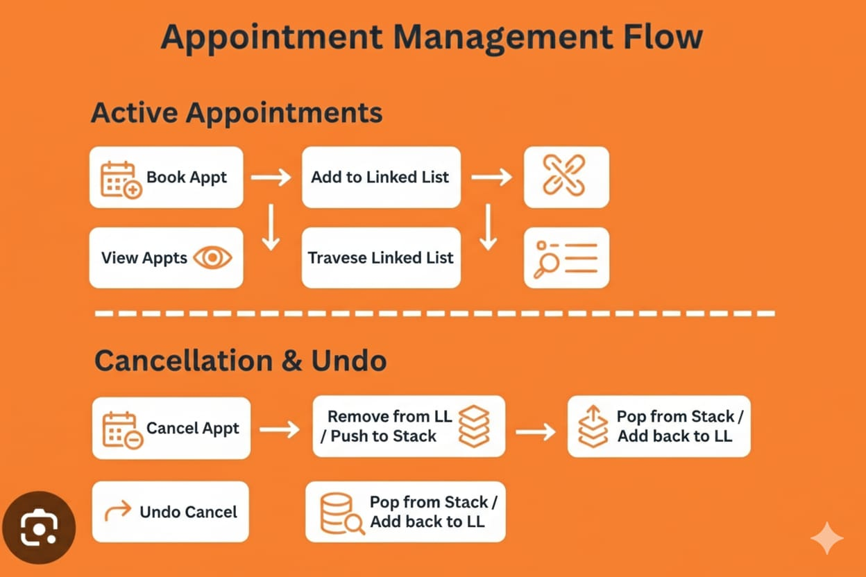
Appointment Management Flow

Slide 9
Book Appointments(Insertion)
// Book Appointment
void bookAppointment() {
if(doctorCount == 0){
printf("No doctors available!\n\n");
return;
}
struct Appointment* newAppt = (struct Appointment*)malloc(sizeof(struct Appointment));
newAppt->token = tokenCounter++;
printf("Enter Patient Name: ");
scanf(" %[^\n]s", newAppt->patient);
printf("Enter Contact: ");
scanf(" %[^\n]s", newAppt->contact);
printf("Choose Department:\n");
for(int i=0;i<deptCount;i++){
printf("%d. %s\n", i+1, departments[i].name);
}
int d;
scanf("%d", &d);
strcpy(newAppt->department, departments[d-1].name);
printf("Choose Doctor:\n");
int count = 1;
int docIndex[MAX];
for(int i=0;i<doctorCount;i++){
if(strcmp(doctors[i].department, newAppt->department)==0){
printf("%d. %s\n", count, doctors[i].name);
docIndex[count-1]=i;
count++;
}
}
int docChoice;
scanf("%d", &docChoice);

Slide 10
strcpy(newAppt->doctor, doctors[docIndex[docChoice-1]].name);
// Time input with conflict check
int valid = 0;
while(!valid){
printf("Enter Time (HH:MM): ");
scanf(" %[^\n]s", newAppt->time);
// Check for conflicts
struct Appointment* temp = head;
valid = 1; // assume valid until conflict found
while(temp != NULL){
if(strcmp(temp->doctor, newAppt->doctor)==0 && strcmp(temp->time, newAppt->time)==0){
printf(" Time slot already booked with %s at %s. Please choose another time.\n",
newAppt->doctor, newAppt->time);
valid = 0;
break;
}
temp = temp->next;
}
}
newAppt->next = NULL;
// Add to linked list
if(head == NULL) head = newAppt;
else {
struct Appointment* temp = head;
while(temp->next != NULL) temp = temp->next;
temp->next = newAppt;
}
printf(" Appointment booked successfully! Token No: %d\n\n", newAppt->token);
}

Slide 11
View Appointments(Traversal)
void viewAppointments() {
if(head==NULL){ printf("No appointments found.\n\n"); return; }
struct Appointment* temp = head;
printf("\n--- All Appointments ---\n");
while(temp != NULL){
printf("Token: %d | Name: %s | Contact: %s | Department: %s | Doctor: %s | Time: %s\n",
temp->token, temp->patient, temp->contact, temp->department, temp->doctor, temp->time);
temp=temp->next;
}
printf("\n");
}

Slide 12
Cancel Appointment(Deletion from LL&Push into Stack)
void cancelAppointment() {
if(head==NULL){ printf("No appointments to cancel.\n\n"); return; }
int token;
printf("Enter Token to cancel: ");
scanf("%d", &token);
struct Appointment *temp=head,*prev=NULL;
while(temp!=NULL && temp->token!=token){ prev=temp; temp=temp->next; }
if(temp==NULL){ printf("Appointment not found!\n\n"); return; }
if(prev==NULL) head=temp->next;
else prev->next=temp->next;
temp->next=NULL;
push(temp);
printf("Appointment canceled successfully!\n\n");
}

Slide 13
Undo Cancellation (Pop)
void undoCancellation() {
struct Appointment* last = pop();
if(last==NULL){ printf("No canceled appointments.\n\n"); return; }
if(head==NULL) head=last;
else {
struct Appointment* temp=head;
while(temp->next!=NULL) temp=temp->next;
temp->next=last;
}
printf("Last canceled appointment restored! Token: %d\n\n", last->token);
}

Slide 14
Book Appointments
=== Hospital System ===
1. Book Appointment
2. View Appointments
3. Cancel Appointment
4. Undo Last Cancel
5. Exit
Enter choice: 1
Enter Patient Name: abc
Enter Contact: 123
Choose Department:
1. Cardiology
2. Neurology
3. Orthopedics
4. Pediatrics
5. Dermatology
1
Choose Doctor:
1. Dr. Smith
2. Dr. Johnson
1
Enter Time (HH:MM): 10:00
Appointment booked successfully! Token No: 1

Slide 15
View Appointments
=== Hospital System ===
1. Book Appointment
2. View Appointments
3. Cancel Appointment
4. Undo Last Cancel
5. Exit
Enter choice: 2
--- All Appointments ---
Token: 1 | Name: abc | Contact: 123 | Department: Cardiology | Doctor: Dr. Smith | Time: 10;00
Token: 2 | Name: bcd | Contact: 234 | Department: Neurology | Doctor: Dr. Lee | Time: 9:00

Slide 16
Cancel Appointments
=== Hospital System ===
1. Book Appointment
2. View Appointments
3. Cancel Appointment
4. Undo Last Cancel
5. Exit
Enter choice: 3
Enter Token to cancel: 1
Appointment canceled successfully!

Slide 17
Restore Appointments
=== Hospital System ===
1. Book Appointment
2. View Appointments
3. Cancel Appointment
4. Undo Last Cancel
5. Exit
Enter choice: 4
Last canceled appointment restored! Token: 1

Slide 18
Conclusion
This project demonstrates the use of Linked List and Stack data structures in a real-life application like hospital appointment systems. It provides practical exposure to dynamic memory handling, stack operations, and menu-driven programming in C.

Slide 19
References:
Classic Data Structures - D.Samantha
Fundamentals of Data Structures - Ellis Horowitz Sartaj Sahni
Lecture Notes

Slide 20
Thank You

